Slide 1
Reverse Engineering: Safe Environment
Computer Security Practice

Slide 2
WARNING!!!
Be careful
Always store and transport suspected malware in a password protected and encrypted archive, such as ZIP or RAR. Use a common password such as “infected”; not to protect the contents, but to prevent accidental examination or execution. This prevents antivirus and other security products from removing or quarantining the malware.
Homework password – “infectednus”
Use a modern version of your primary operating system and ensure that system is fully patched and updated.
Ensure that all third party software is fully patched and updated.
Disable preview views.
Disable autorun or automount features.
Handle suspected malware while logged in as a non-privileged user.
Add an underscore to the end of suspected malware file extensions or renamed the extension to help prevent accidental execution or opening. For example change the extension “.exe” into “.exe_”.
Store all suspected malware and malware archives in a directory that denies execution, and only allows access to a non-privileged user.
Do not access or launch suspected malware unless you are operating in a virtual machine or other isolated analysis environment. The exceptions are to initially save the file to your hard drive, create the storage archive, or transfer the archive to your analysis environment. We even recommend avoiding the computation of a checksum or viewing strings unless you are in a virtual environment. You should develop the natural habit of only working with malware in the virtual environment.

Slide 3
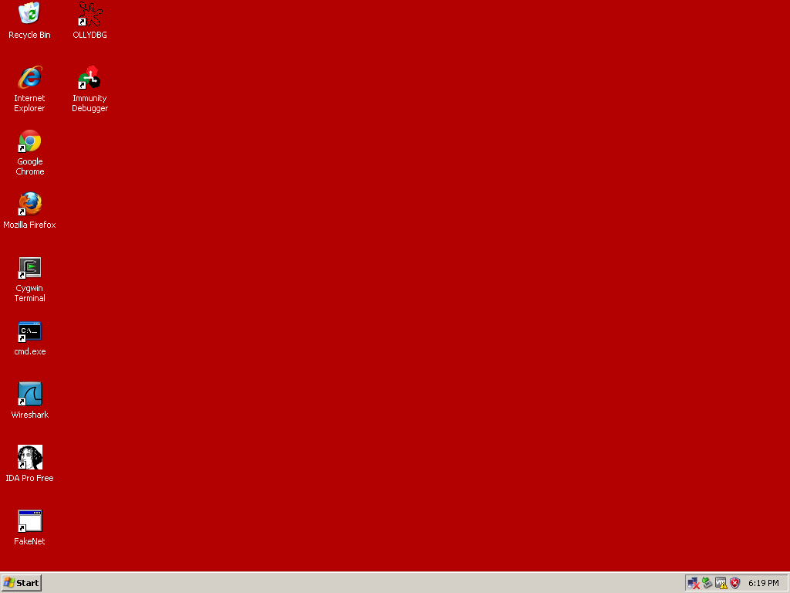
Virtual Machine
What is a VM?
Windows XP / 10
Your Safe Environment
Take frequent snapshots
We will use Flare-VM
Delete after class
*Use for education only*

